Slide 1
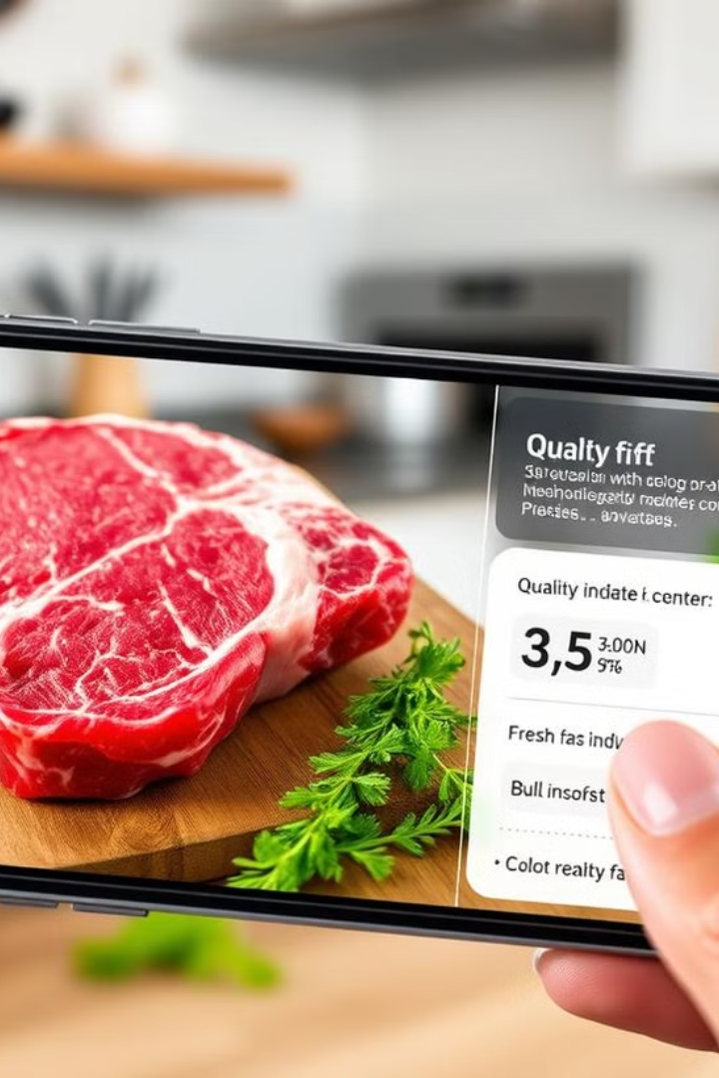
Final Year Project BSCS ( 2021-2025 ) External Project Presentation
Dated: 25.7.2025
A Real Time Non-Destructive AR Based Mobile Application for Assuring the Quality of Raw Meat Items
Supervisor: Dr. Mariam Nosheen
Team Members
Ayesha Munawar 2125110012
Ghania Shahzad 2125110018
Raessa Asif 2125110046
Shifa Zahra 2125110056

Slide 2
Agenda of Todays Presentation
1. Introduction 7. Conclusion and Future Enhancement
Scope 8. References
Problem Statement
Architecture Diagram
2. Literature Review
3. Project Management
4. Software Requirement Specification
Functional and Non functional Requirement
Use case Diagram
5. Software Design Specification
Class Diagram
Sequence Diagram
6. Proposed Work
Taxonomies
Proposed Model
Mobile Application
Demo

Slide 3
A Real Time Non-Destructive AR Based Mobile Application for Assuring the Quality of Raw Meat Items
A technique to analyze the quality of raw meat items without damaging or destroying them during analysis.
Uses Augmented Reality to visualize quality assessments interactively via a mobile app.
Refers to uncooked meat from livestock, poultry,
and seafood.

Slide 4
Project Scope
The modules of the proposed solution are
Mobile App Manager
Raw Meat Item Type Classification
Raw Meat Quality Classification
Raw Meat Quality Assurance Estimation
AR Based Report Generation

Slide 5
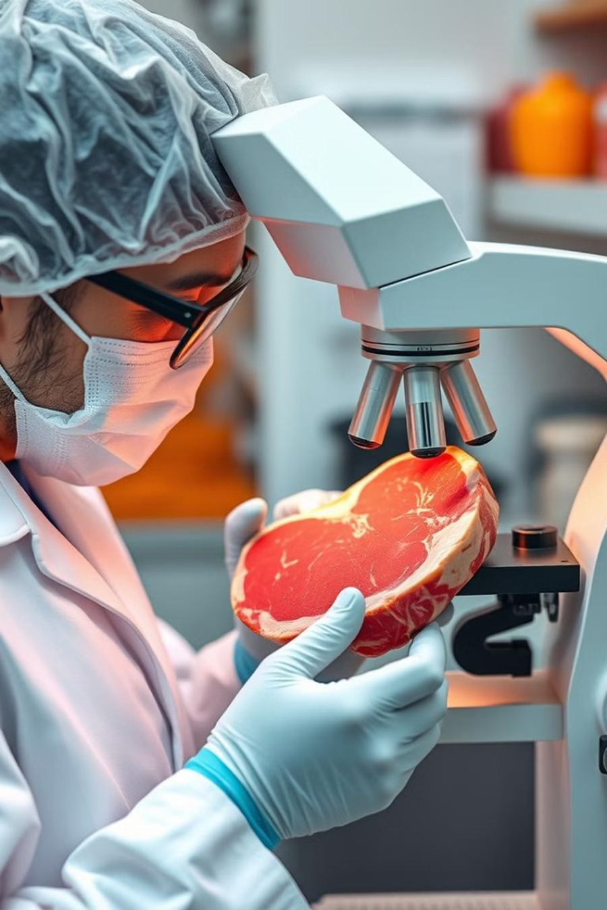
Problem Statement
The traditional destructive method of assuring the quality of meat items are time consuming, less accessible and need expensive equipment resource (i.e. human, machine etc.) which is very difficult for common consumers to afford.

Slide 6
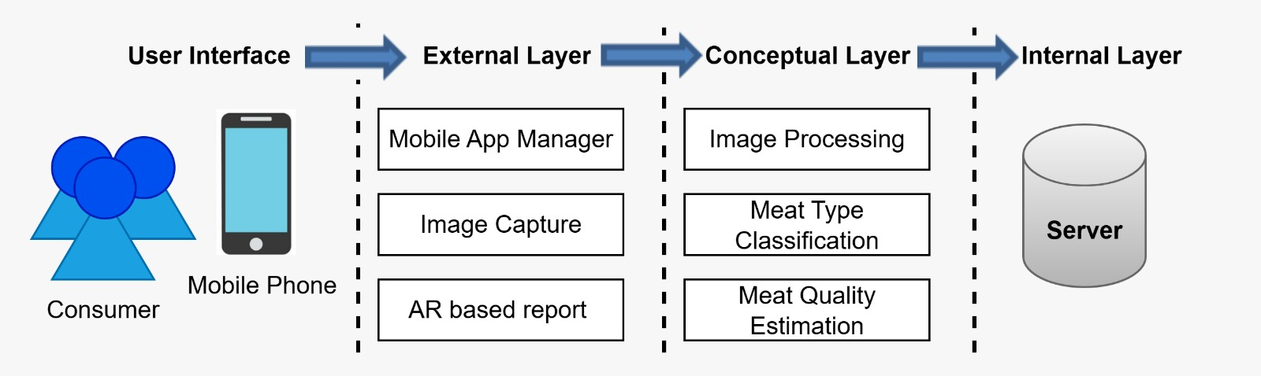
Architecture Diagram
Figure 1. Three Tier Architectural Diagram of the Proposed Project

Slide 7

Literature Review
Key Findings:
Require Laboratory equipment
Uses Sensory approach
Require Human and Machine resources
Time Consuming and require Human Effort
Costly Controlled Environment
Not easily accessible to everyone
Review of raw meat quality assurance tools, techniques and methodologies.
Review of software based solution for estimating the quality assurance of meat items.

Slide 8
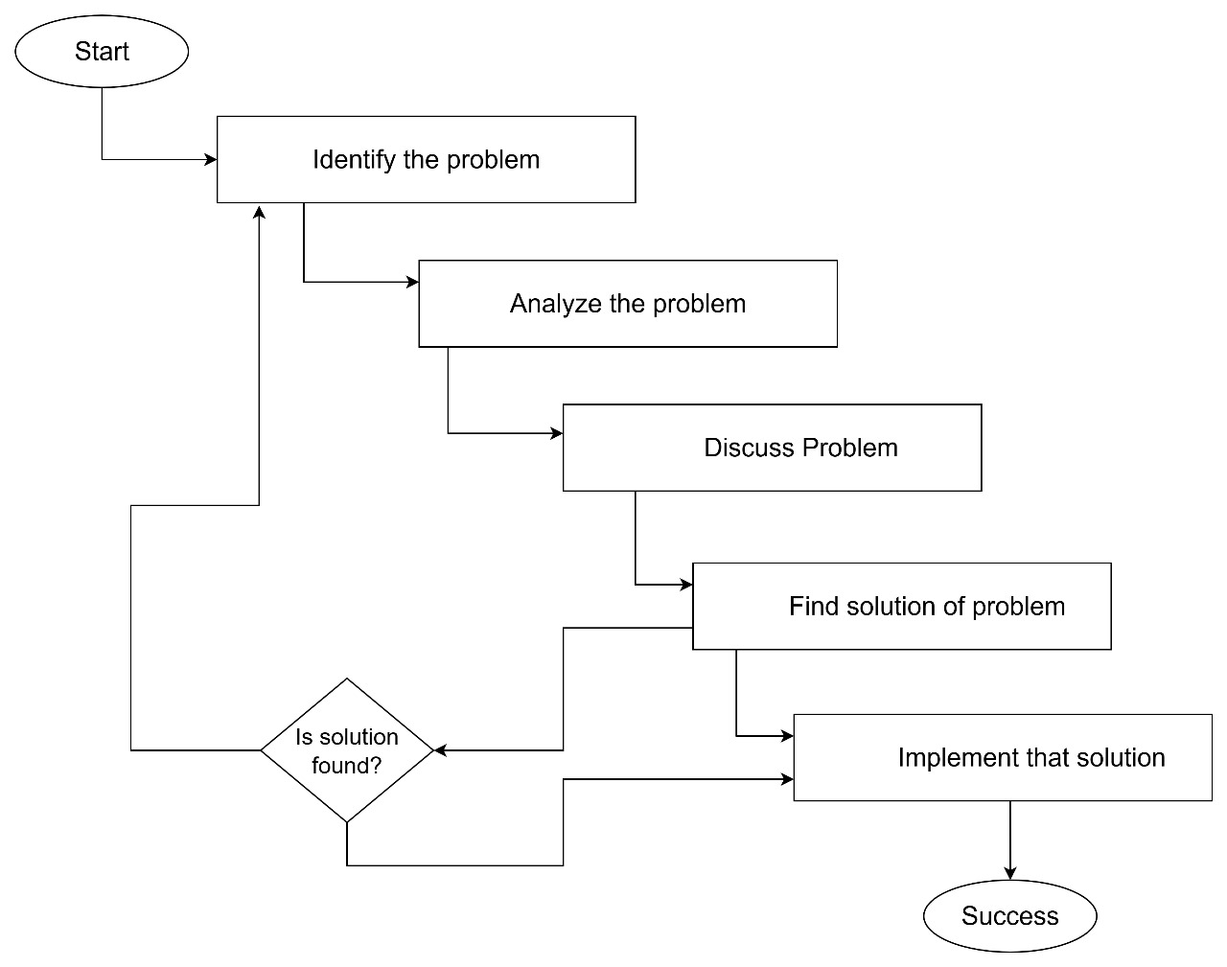
Project Management
Figure 2: Software Quality Plan of Proposed Project

Slide 9
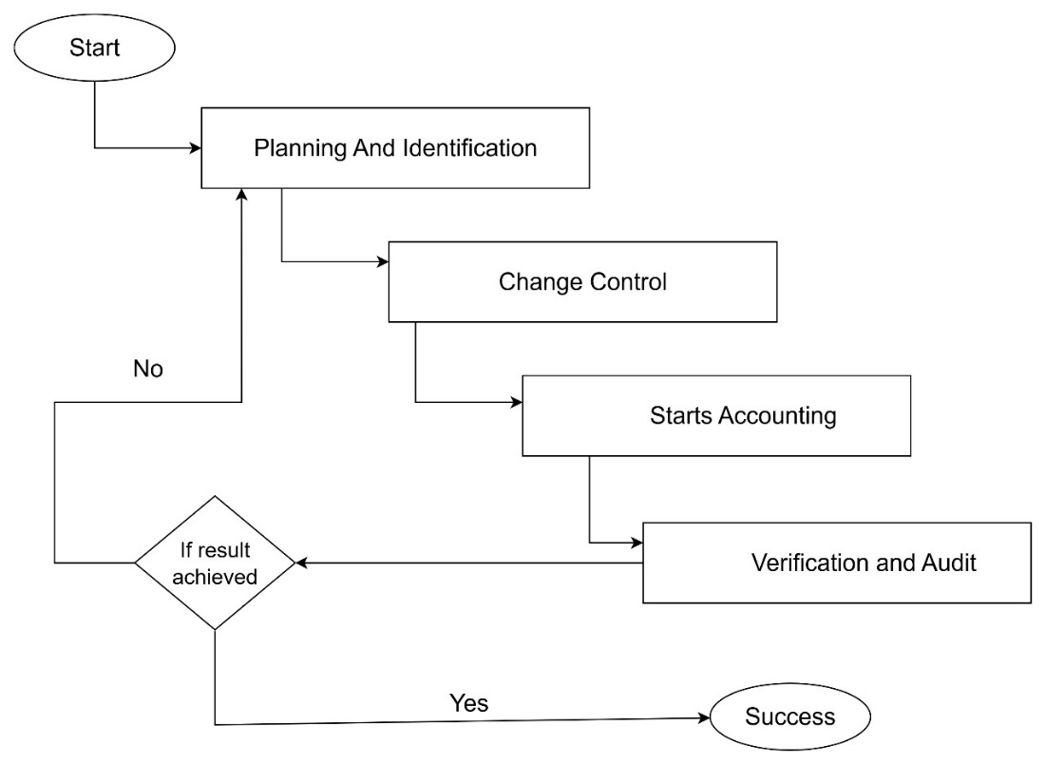
Project Management
Figure 3: Software Configuration Plan of Proposed Project

Slide 10
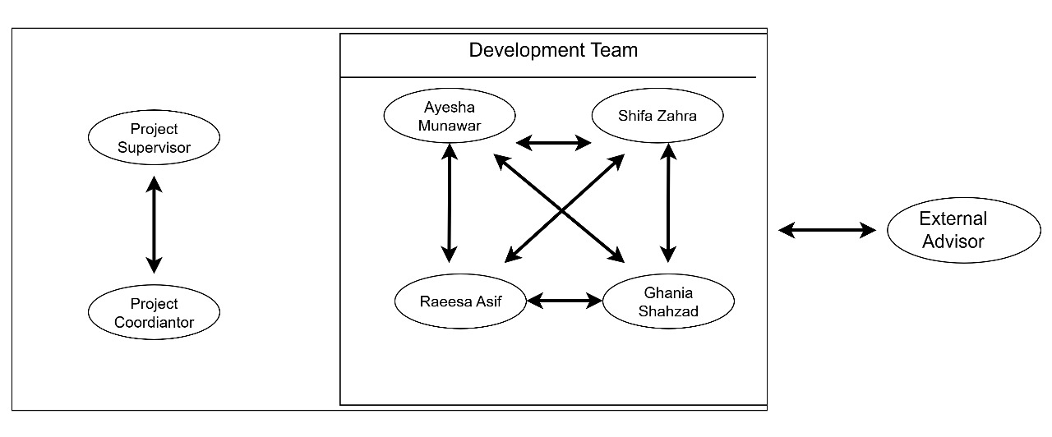
Project Management
Figure 4: Team Structure of Proposed Project

Slide 11
Software Requirement Specification
Functional Requirement
Mobile App Manager
Image Processing
Meat Type Classification
Real-Time Freshness Analysis
Freshness Classification Output
Generate AR Report
Non-Functional Requirement
• Performance Requirements
• Platform Compatibility
• Reliability

Slide 12
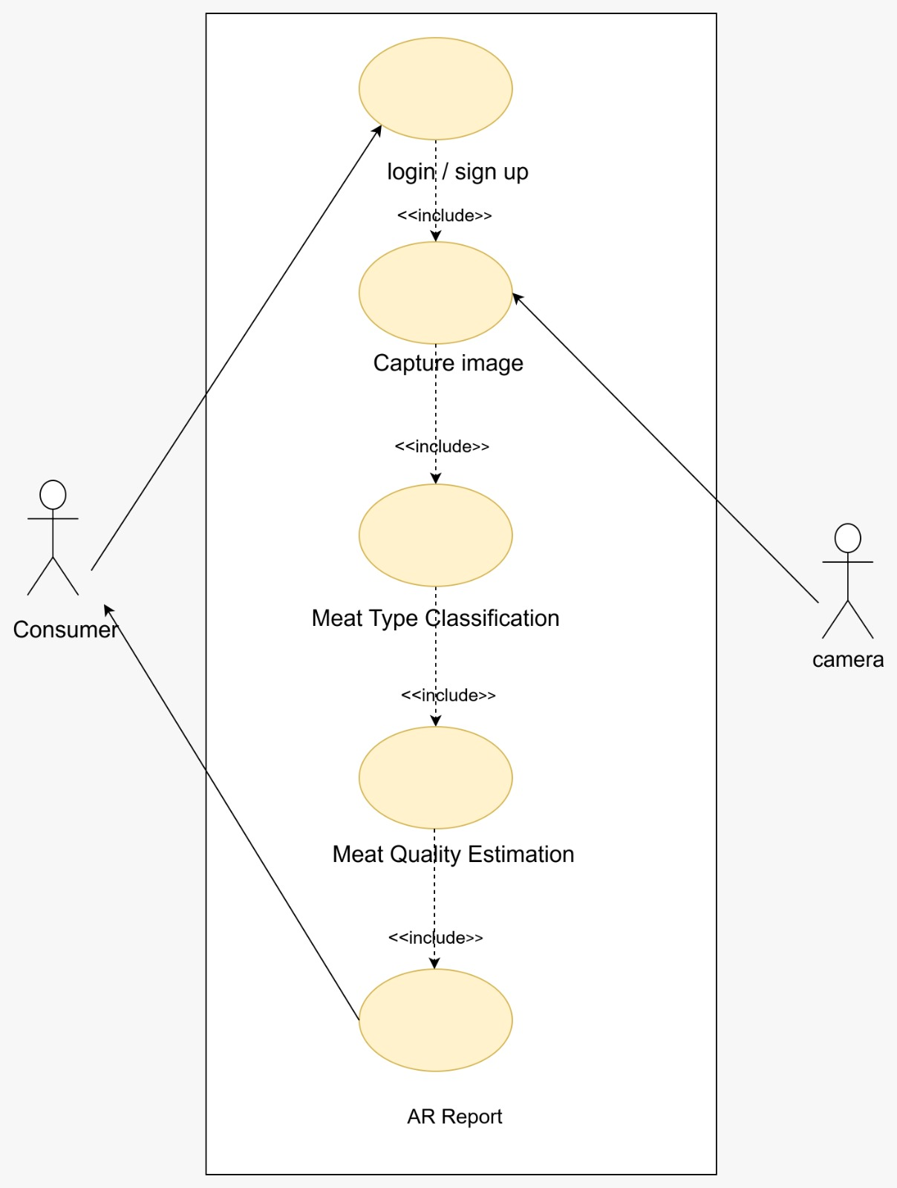
Use case

Slide 13
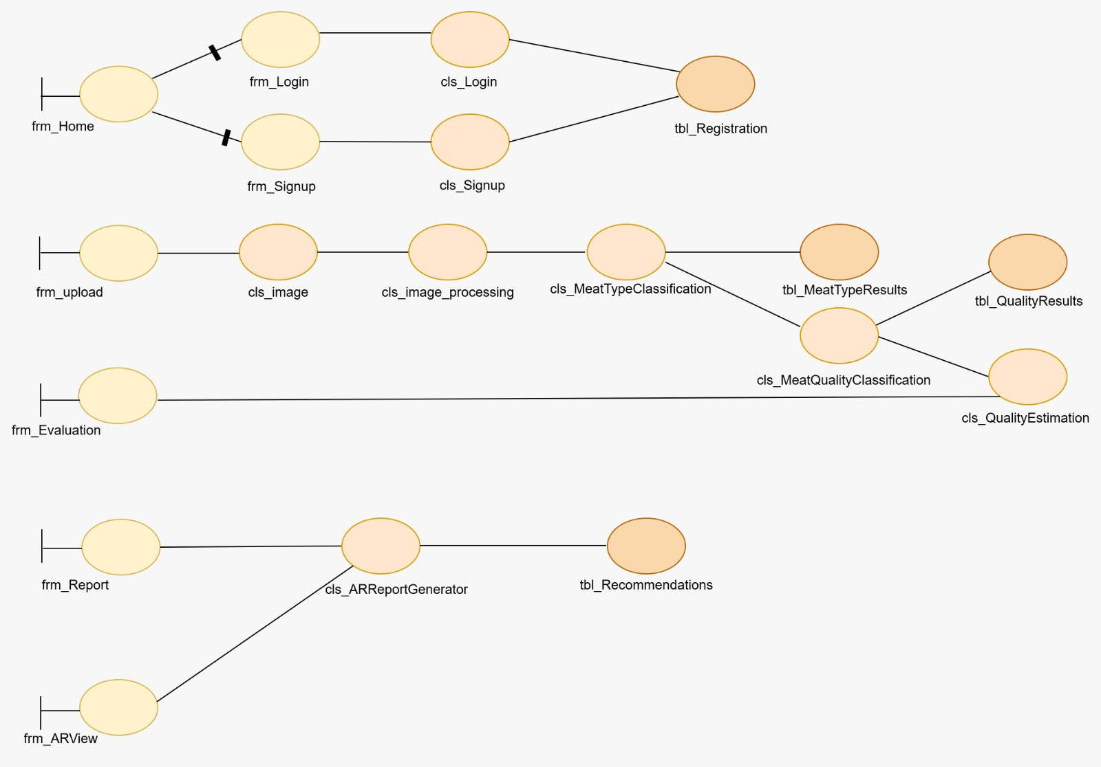
Software Design Specification Class Diagram

Slide 14
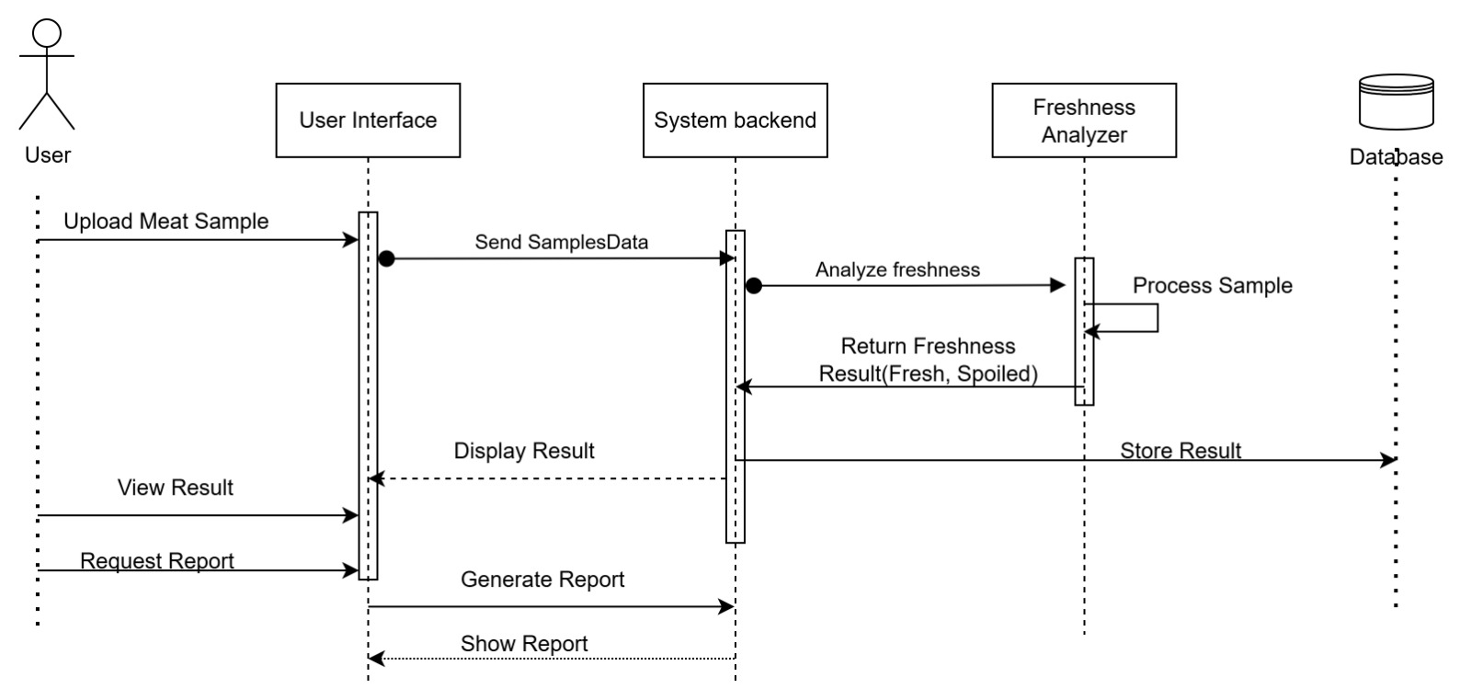
Sequence Diagram

Slide 15
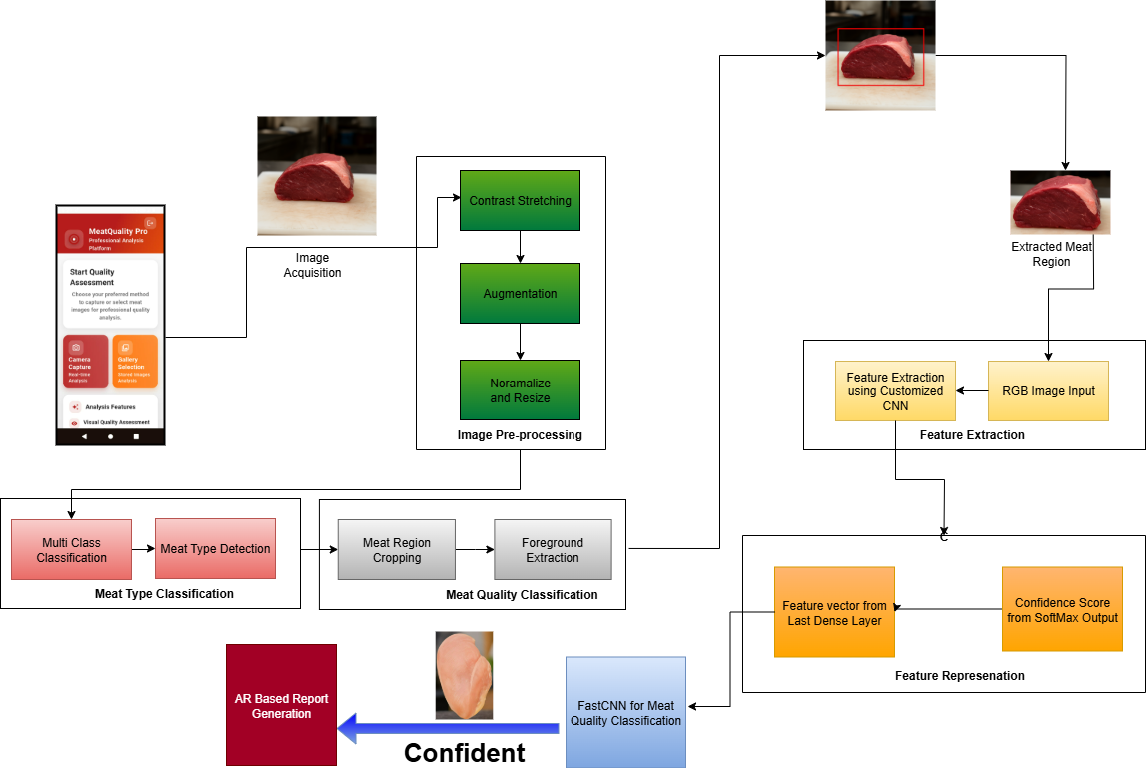
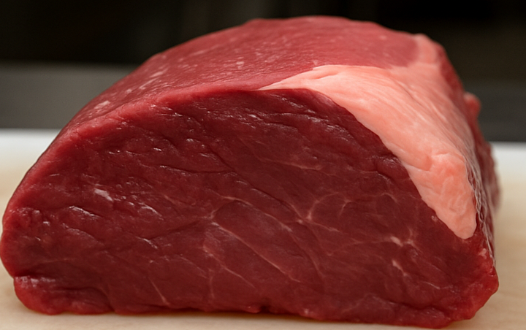
Proposed Model

Slide 16
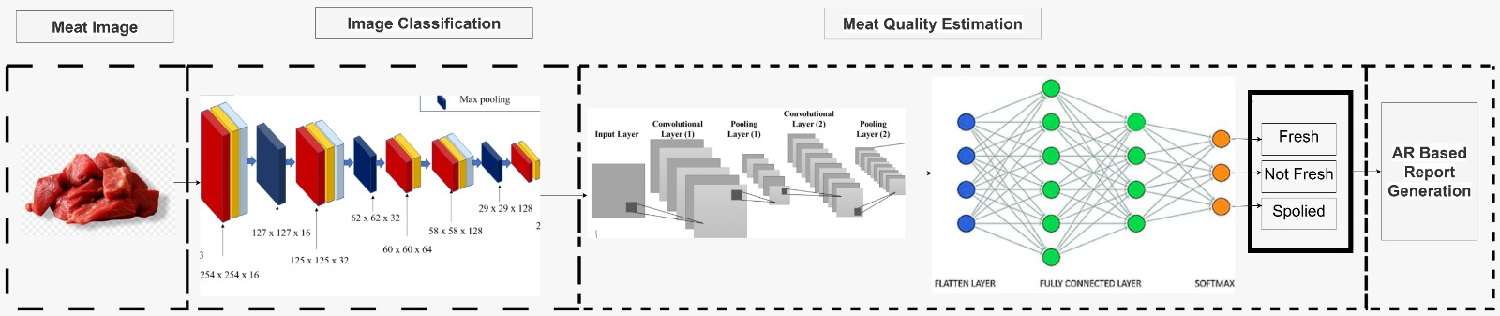
Layer Diagram

Slide 17
Dataset Details
Classes | Sub-Class | No of Images | No of Instances | Sources
Beef | Fresh | 1000 | 600 | Market, Online Datasets
 | Half-Spoiled | 600 | 400 | Mall, Butcher, Online Datasets
 | Spoiled | 500 | 300 | Waste Samples, Online Datasets
Chicken | Fresh | 1000 | 450 | Market, Online Datasets
 | Half-Spoiled | 600 | 300 | Wet Market, Online Datasets
 | Spoiled | 400 | 250 | Rotten Waste, Online Datasets
Fish | Fresh | 1000 | 500 | Slaughter House, Market, Online
 | Spoiled | 400 | 200 | Waste Cuts, Rotten Meat Dataset

Slide 18
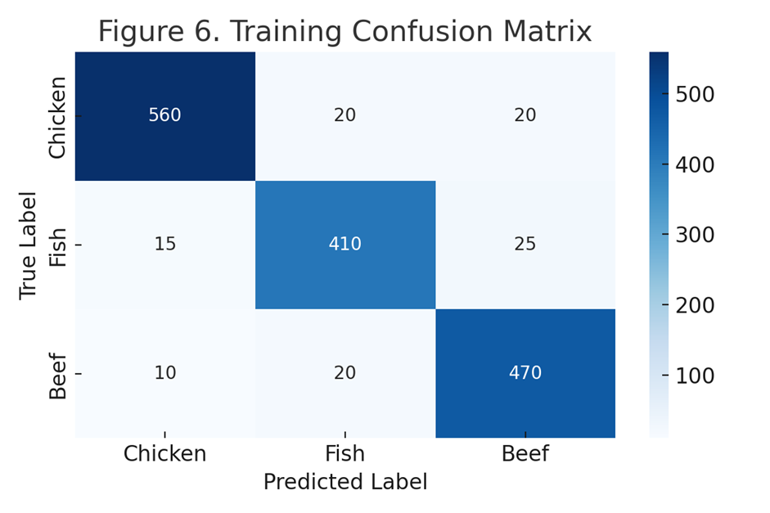
Training Data Results
Meat Class | Precision | Recall | F-Score | Support
Chicken | 0.96 | 0.93 | 0.95 | 600
Fish | 0.91 | 0.91 | 0.91 | 450
Beef | 0.91 | 0.94 | 0.93 | 500

Slide 19
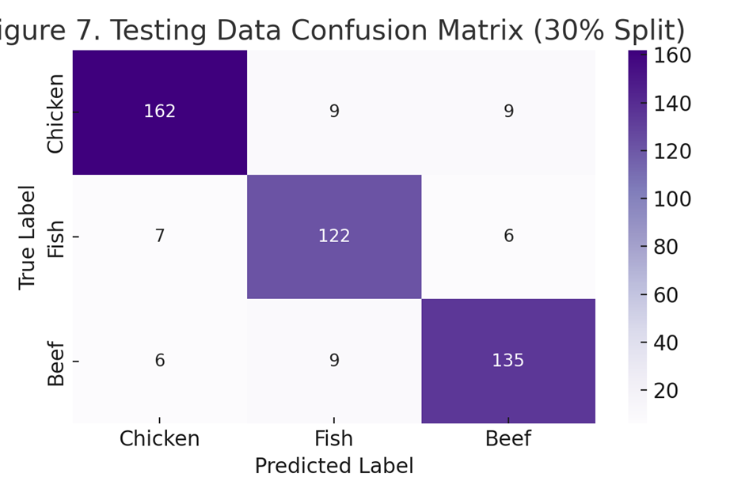
Testing Data Results
s
Meat Class | Precision | Recall | F-Score | Support
Chicken | 0.93 | 0.90 | 0.91 | 180
Meat | 0.87 | 0.90 | 0.89 | 135
Beef | 0.88 | 0.90 | 0.89 | 150

Slide 20
Comparison Results with Other Deep Learning Models
Deep Learning Method | Accuracy | Precision | Recall | F-Score
Fast CNN + ResNet (Proposed) | 92.6% | 0.93 | 0.90 | 0.91
VGG16 | 88.2% | 0.89 | 0.86 | 0.87
MobileNetV2 | 85.5% | 0.86 | 0.84 | 0.85
InceptionV3 | 89.7% | 0.90 | 0.87 | 0.88

Slide 21
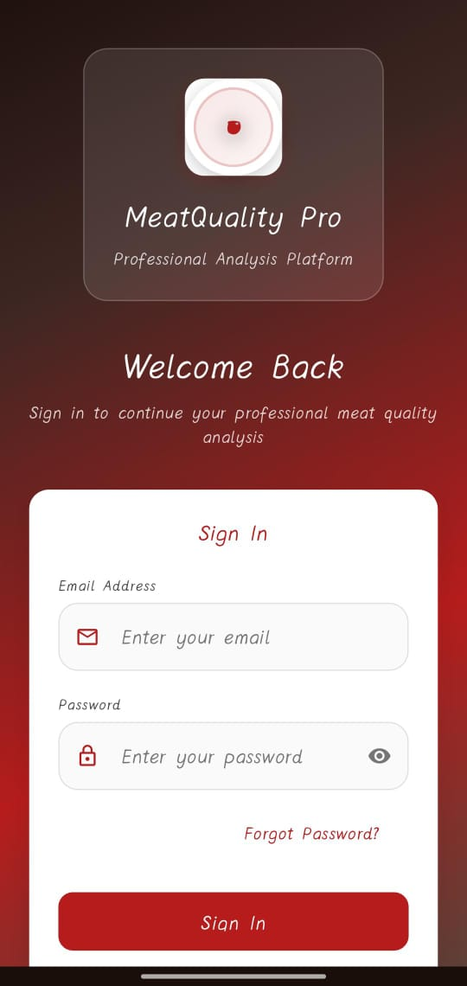
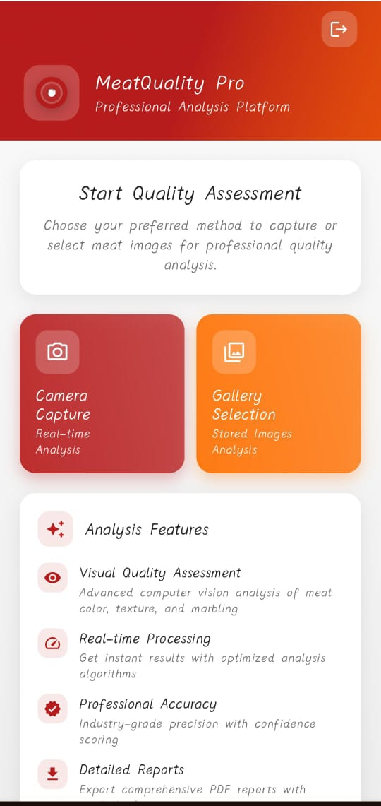
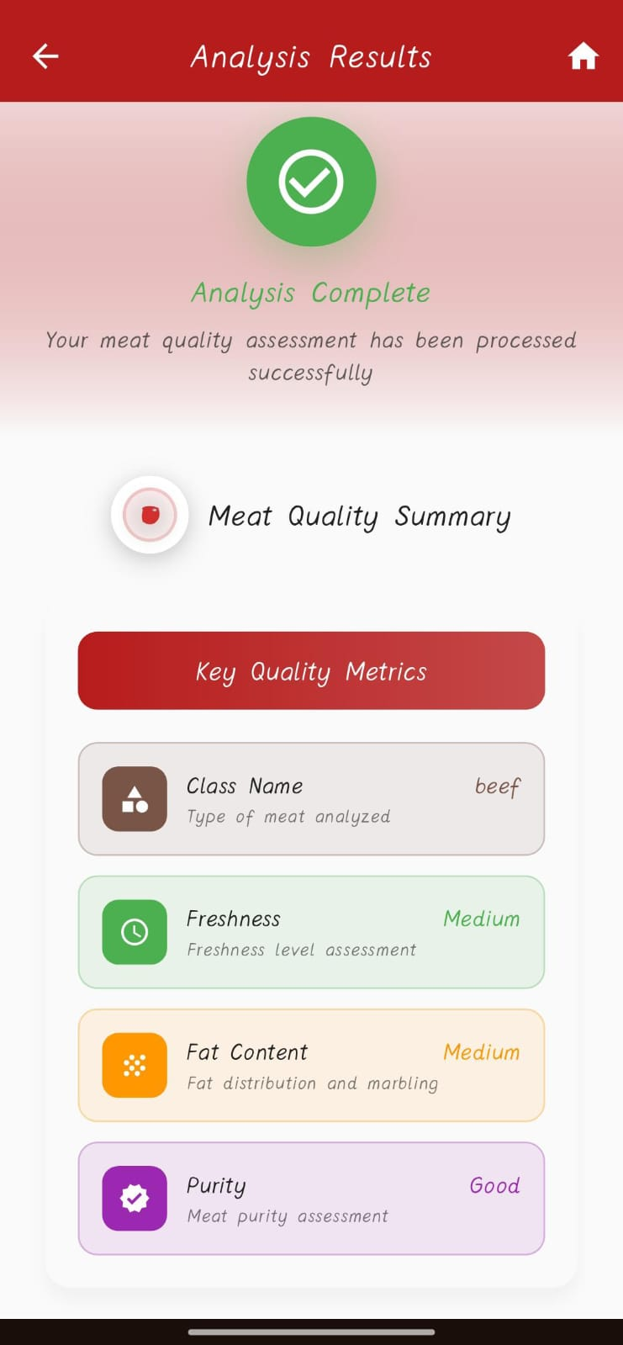
MOBILE APPLICATION

Slide 22
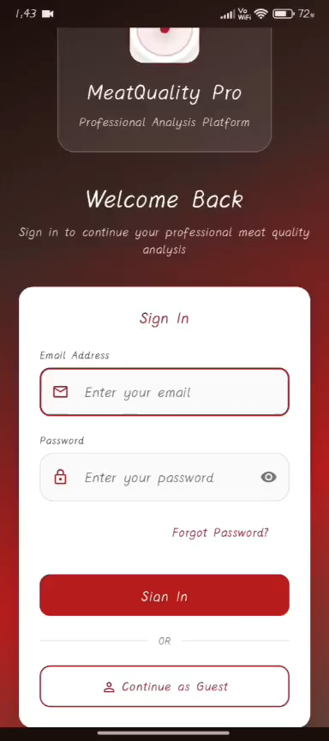
DEMO

Slide 23
Conclusion
Meat quality is tightly related to human life and it is the most critical aspect for consumers to consider when purchasing such items. Traditionally, non-destructive approaches have been used to estimate the physiological and morphological features of raw meat items which is also time consuming. This real-time application provide a more accurate, efficient, and cost-effective solution compared to traditional methods. It not only enhances quality assurance but also makes the system easily accessible for local vendors, ensuring consumers have access to fresher and high quality meat .

Slide 24
Future Enhancement
In the future, the application can be enhanced by
Support more meat types
Adding more instances of datasets
Additional improvements include building a user feedback loop for model retraining.

Slide 25
References
[1]. Xiaohong Wu 1, Non-Destructive Techniques for the Analysis and Evaluation of Meat Quality and Safety, 2022.
[2]. Eric Zhou 1, Developing a Prototype Device for Assessing Meat Quality Using Autofluorescence Imaging and Machine Learning Techniques, 2024.
[3]. Philip Donald C. Sanchez a, Emerging nondestructive techniques for the quality and safety evaluation of pork and beef: Recent advances, challenges, and future perspectives, 2022.
[4]. K. J. a, "Hyperspectral imaging–based assessment of fresh meat quality: Progress and applications," Microchemical Journal, vol. 197, 2024.
[5]. P. Elangovan, "A Novel Approach for Meat Quality Assessment Using an Ensemble of Compact Convolutional Neural Networks," 2024.

